Slide 1
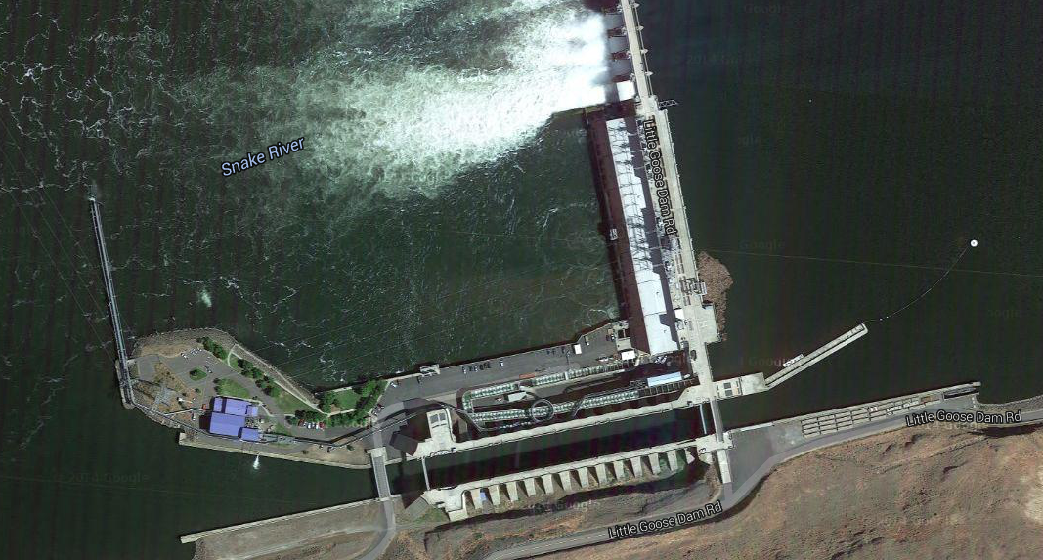
Existing WQ TDG Probe Downriver on North Shore
Existing WQ raft – TMT temperature string
Bypass Pipe Terminus for Spill Mixing Influences – string @ 10-20 ft intervals
Nav Guide Wall for adult post-exit exposure – string @ 10 ft intervals
Ladder Exit & Diffuser Intake – string @ 10 ft intervals
South Shore for Turbine Unit 1 and 2 Influence
Ladder Entrance Junction Pool
Lower Ladder TurnPool above Count Window
Down-ladder Diffuser 15 Weir
Ladder Exit Pool
New Downriver South Shore Probe across Channel from North Shore TDG Probe

